Slide 1
PRINCIPLES
OF
PIPELINING
Compiled by
Dr. N. Gopalakrishna Kini
Professor, Dept. of CSE
MIT, Manipal

Slide 2
Linear Pipeline Processors:
S1
S2
Sk
Linear pipelines are applied for instruction execution, arithmetic computation and memory access operations.
…The processed results are passed from stage S_{i} to stage S_{i+1} for all i= 1, 2, …..k-1. The final result emerges from last stage S_{k}.
Depending on control of data flow along the pipeline, linear pipelines are classified into 2 categories:
Asynchronous pipeline
Synchronous pipeline

Slide 3
1. Asynchronous Linear pipeline:
Ready
Ready
S1
S2
Sk
Ack
Ack

Slide 4
2. Synchronous Linear Pipeline Computers
A pipeline computer performs overlapped computations to exploit temporal parallelism.
A pipeline is a sequence of functional units ("stages") which performs a task in several steps.
Pipeline consists of cascade of processing stages.
Information flows between adjacent stages are under the control of a common clock applied to all latches simultaneously.

Slide 5
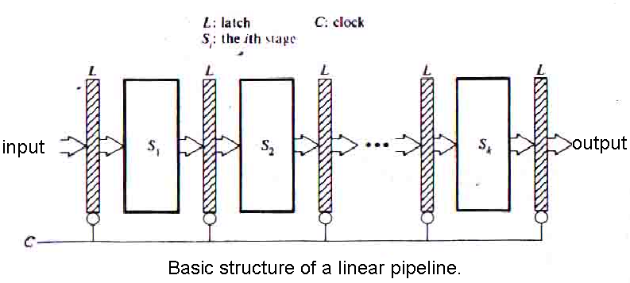
Stages: are pure combinational circuits performing arithmetic and logic over the data streaming flow through the pipe.
Latches: are fast registers for holding the intermediate results between the stages.

Slide 6
Principles of Linear Pipelining
Clock Period of a linear pipeline is defined by
Highest time delay of Stage + Time Delay of latch
τ_{p} = max { τ_{i} }^{k}₁ + τ_{l} = τ_{m} + τ_{l}
τ_{i} time delay of stage S_{i}
τ_{l} time delay of latch
τ Clock period

Slide 7
Principles of Linear Pipelining
Clock periods (T_{k}) required to execute N tasks in a K stages pipeline:
T_{k} = k + (n-1)
Time required:
= [k + (n-1)] x τ
In a nonpipeline processor, the same number of tasks would take
T1 = k x n
Time required:
= k n τ

Slide 8


Principles of Linear Pipelining
Speed Up of a k-stage linear-pipeline processor over an equivalent nonpipeline processor is defined as:
S_{k} =
S_{k} =
This is called the “Actual Speed Up”

Slide 9

Principles of Linear Pipelining
The maximum speed up “Ideal Speed Up” is when S_{k} → k, for n >> k.
S_{k} =
S_{k} = k
In other words the maximum speed that a linear-pipeline can provide is k , where k is the number of stages in the pipe.

Slide 10
Principles of Linear Pipelining
Efficiency: The efficiency of a linear pipeline is measured by the percentage of busy time-space spans over the total time-space.
Total time space span is equal to the sum of all busy and idle time space spans.
Let n, k, ح be the number of tasks (instructions), the number of pipeline stages and the clock period of a linear pipeline respectively, the pipeline η is

Slide 11
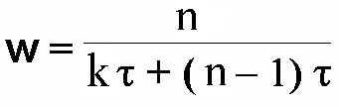

Principles of Linear Pipelining
Throughput: The number of results (tasks) that can be completed by a pipeline per unit time is called its throughput. This rate tells the computing power of a pipeline.
In terms of efficiency η and clock period τ of a linear pipeline, throughput is:

Slide 12
Classification of Pipeline Processors:
As per the levels of processing, the pipelined processors are classified as
Arithmetic pipelining
Instruction pipelining
Processor pipelining

Slide 13
Arithmetic pipelining:
The ALU of a computer can be segmentized for pipeline operations in various data formats.
Ex: 4 stage pipeline is in STAR-100
14 stage pipeline is in CRAY-1
26 stage pipeline is in Cyber-205
2. Instruction pipelining:
Execution of a stream of instructions can be pipelined by overlapping the execution of current instrn with fetch, decode and operand fetch of subsequent instrn.

Slide 14
3. Processor pipelining:
This refers to pipeline processing of the same data stream by a cascade of processors each of which processes a specific task.
The data stream passes the first processor with the results stored in a memory block which is also accessible by second processor.
The second processor then passes the refined result to third and so on.

Slide 15
Classification of Pipeline Processors:
As per the pipeline configuration and control strategies pipeline classification schemes are
1. Unifunctional vs. Multifunctional Pipeline
2. Static vs. Dynamic Pipeline
3. Scalar vs. vector pipeline

Slide 16
1. Unifunctional vs. Multifunctional Pipeline:
Unifunctional pipeline is designed to perform single task. i.e. A pipeline unit with a fixed and dedicated function is called unifunctional.
CRAY-1 has 12 unifunctional pipeline units for various scalar, vector, fixed point and floating point operations.

Slide 17
1. Unifunctional vs. Multifunctional Pipeline (Contd..):
Multifunctional pipeline is designed to perform different functions either at the same time or different times by interconnecting different subsets of stages in the pipeline.

Slide 18
2. Static vs. Dynamic Pipeline:
A static pipeline allows only one functional configuration at a time.
It can either unifunctional or multifunctional.

Slide 19
2. Static vs. Dynamic Pipeline (contd..):
A dynamic pipeline allows several functional configurations to exist simultaneously.
A dynamic pipeline must be multifunctional. It requires much more elaborated control and sequencing mechanism.

Slide 20
3. Scalar vs. vector pipeline:
A scalar pipeline processes a sequence of scalar operands under the control of DO loop.
Instructions in a small DO loop are often prefetched into instruction buffer.
The required scalar operands are moved into the data cache in order to continuously supply the pipeline with operands.
Vector pipeline are specially designed to handle vector instructions over vector operands.
Computer having vector instructions are often called vector processors.

